Slide 1
Introductory Presentation
Blaine Killen

Slide 2
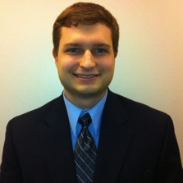
Background
Hometown: Houston, Texas
Age: 21 years old
High School: Glenda Dawson High School
Distinguished Graduate

Slide 3

Travel
Vacationed in Canada and Bahamas
Shortly visited Paris, London, Dublin
Plan on attending Asiatech in the future

Slide 4


Education
Junior by credit and actual standings
Dual: Information Technology and Management and Finance
Future: MBA in Computer Engineering from Stanford University

Slide 5

Professional Experience
Co-founder in one Sandbox startup
Contracted web development
Invented a TV remote controlled by Twitter

Slide 6

Focus
Applying psychology from marketing and humanistic studies to UI/UX design
Operating system optimization for systems with minimal technical specifications
Desktop application cloning on the cloud through web application development

Slide 7
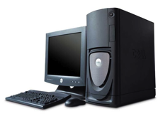
Hobbies
Active golf enthusiast
Working out
Anything software or hardware computer related
Web development ( jQuery, Rails, HTML, CSS, Obj. C )

Slide 8

Future Goals
Work for a major technology company in silicon valley
Bring innovation to the technology industry
Start my own hardware technology company

Slide 9
Class Experience
Aware of AT&T and Verizon's current plans and pricings
Basic understanding of the technologies behind different marketing terms for wireless technologies
No legal or regulatory knowledge prior to this course

